Slide 1
Social Emotional Mental
Health Difficulties
SE
Led By
Esther Horner

Slide 2
Extent of SEMHD in children and young people
20.3% of children aged 8–16 years had a probable mental disorder in 2023 (approximately 1 in 5 children).
23.3% of young people aged 17–19 years had a probable mental disorder in 2023.
Rates have increased substantially since 2017, when 11.6% of 5–19-year-olds were identified as having a probable mental disorder.

Slide 3
SEMHD as a Special Educational Need
23.6% of pupils receiving SEN Support had SEMHD identified as their primary need (approximately 279,000 pupils).
Among all children and young people with an EHCP in England: 20.7% have SEMHD as their primary need, making it the third most common primary need after Autism

Slide 4
The Key issues
Neurodevelopmental Needs (e.g. Autism, ADHD, Speech and Language Difficulties).
Adverse childhood experiences and trauma.
Mental health conditions such as anxiety and depression.
Educational Factors: challenges and unmet SEND.
Family Factors
Socioeconomic and Environmental Factors.
Trauma and Attachment Difficulties.
Social Media and Modern Pressures.

Slide 5
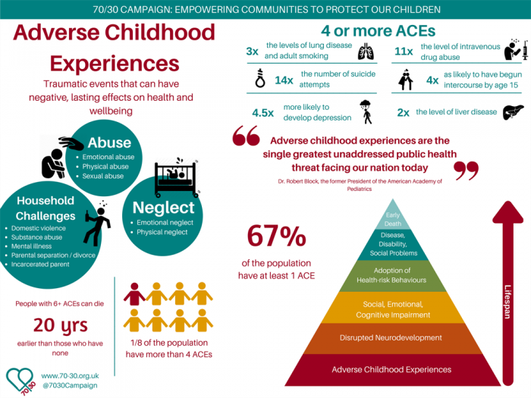

Slide 6

Anxiety

Slide 7
Possible Signs
Skin condition
Mood swings
Breathing difficulties/panic attacks
Seeking adult reassurance/attention for minor issues
Attendance issues
Toilet breaks

Slide 8
How Parents Can Support a Young Person with Anxiety
• Listen calmly and validate feelings without immediately trying to solve the problem
• Maintain predictable routines at home where possible
• Encourage regular sleep, exercise, and healthy eating habits
• Break challenging tasks into small, achievable steps
• Praise effort and bravery rather than outcomes
• Avoid excessive reassurance, which can unintentionally maintain anxiety
• Support gradual exposure to feared situations at a manageable pace
• Teach coping strategies such as deep breathing and grounding techniques
• Work closely with school and other professionals to ensure consistency
• Seek additional support if anxiety is significantly affecting daily life

Slide 9

Depression

Slide 10
Possible Signs
Lethargy
Appearance
Sleep issues
Eating issues
Mood swings/ short fuse
Isolation
Risky behaviours

Slide 11
How Parents Can Support a Child or Young Person with Depression
• Listen without judgement and acknowledge their feelings
• Encourage open conversations and regular check-ins
• Maintain routines for sleep, meals, exercise, and daily activities
• Help them engage in enjoyable activities, even when motivation is low
• Focus on small achievements and celebrate progress
• Avoid criticism or telling them to 'cheer up' or 'snap out of it'
• Encourage social connections with trusted friends and family
• Monitor changes in mood, behaviour, sleep, appetite, and school attendance
• Seek professional support if symptoms persist or worsen
• Take any talk of self-harm or suicide seriously and seek immediate help

Slide 12
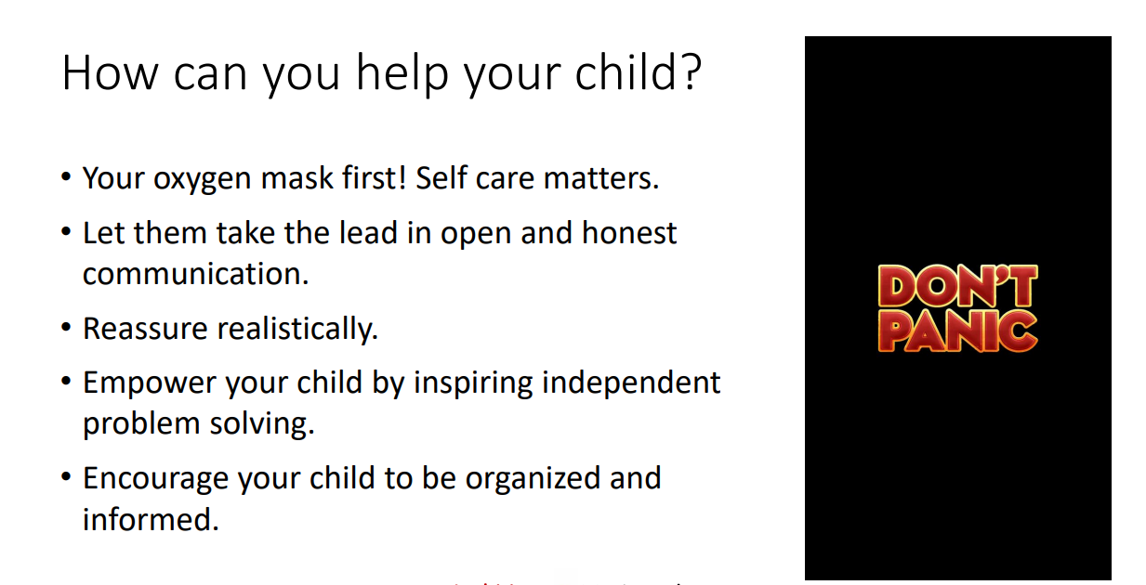

Slide 13
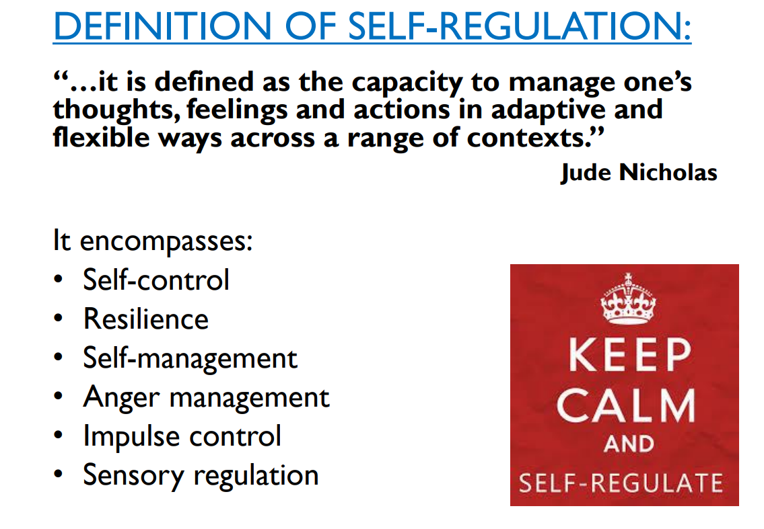
Self Regulation

Slide 14
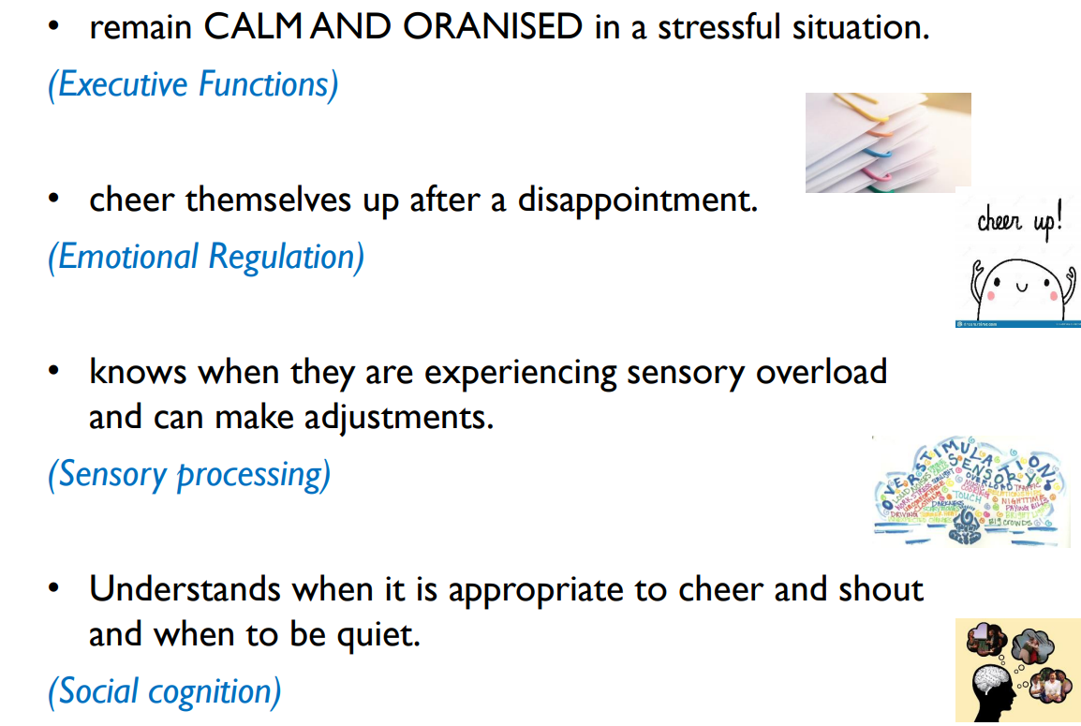
A Person Who can Self Regulate can….

Slide 15
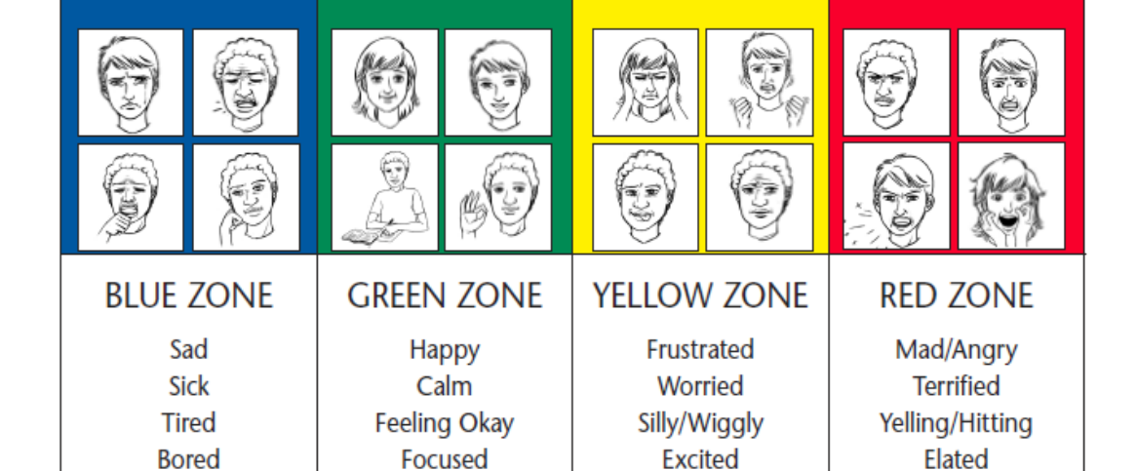
The Zones of Regulation

Slide 16
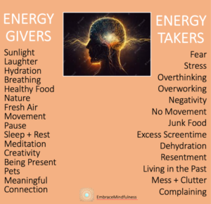

Slide 17
