Slide 1


SATs Information
Evening
May 2027

Slide 2

Do SATs actually matter?

Slide 3


Slide 4
The Fischer Family Trust (FFT)
Non-profit organisation in the UK
FFT uses data on similar students nationally to set aspirational and achievable goals for individuals.
Schools use this data to create personalised targets, which are often based on one of three progress levels:
average (FFT50)
high (FFT20) or
very high (FFT5)

Slide 5
What is an FFT estimate?
An FFT estimate is a grade assigned to each pupil.

Slide 6
How are estimates calculated?
In short, FFT looks at the range of results achieved by similar pupils who took GCSEs in the same subjects in the past. i.e. pupils with the same prior attainment, gender and month of birth.
Key Stage 4 estimates use key stage 2 results as the measure of prior attainment: (reading, GPS, maths)and teacher assessment in writing.

Slide 7
Limitations
The model is relatively simple:
  Any two pupils with the same prior attainment, gender and date of birth will have the same estimate for a given subject.
  Pupils are grouped into Low, Middle or High prior attainment bands
  Expected standard scaled score of 100.
  GCSE prediction Grades 4-5.

Slide 8
Rough Prediction (English)
KS2 scaled score of 95-99
  20-27 out of 50 marks.
Just below expected standard.
GCSE range Grade 3-4 (illustrative).
Pass mark is a Grade 4.
If your child is below expected standard at KS2, significant progress is needed to reach a Grade 4.

Slide 9
Alameda Outcomes 2026
 | Alameda | CBC | National
Reading | 77% | 73% | 75% | +2%
Writing | 74% | 67% | 73% | +1%
Maths | 76% | 70% | 75% | +1%
RWM Combined | 62% | 55% | 63% | -1%

Slide 10
Greater Depth 2026
 | Percentage increase/decrease 2025
Reading | + 13%
Writing | + 5%
Maths | + 2%
RWM Combined | + 8%

Slide 11


Slide 12
“It is widely understood that positive health and wellbeing contribute to a child’s ability to flourish, thrive and achieve”.
(Public Health England 2018)

Slide 13

Our Year 6 message

Slide 14
Our year 6 message
Be kind
Be thoughtful
Be polite
Be helpful
Be focused
Try your best

Slide 15
The children should be focused on our core values and trying their best,
not
SATs scores.

Slide 16

Working together
Staff
Home
Child

Slide 17


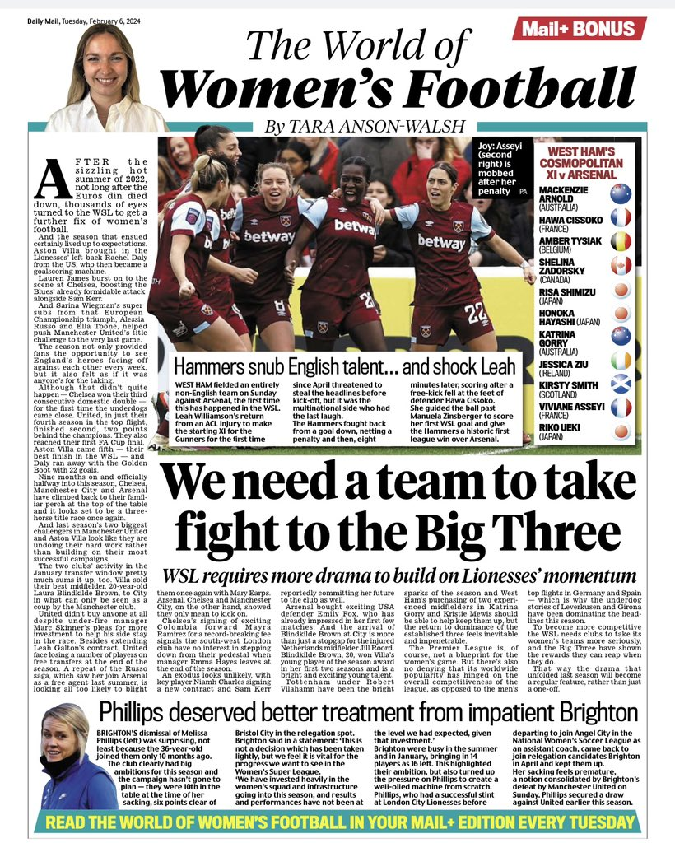

Everyday opportunities

Slide 18
The coming months
Regular conversation
Reassurance
Praise and encouragement
Relaxed environment
Discuss concerns with staff not children

Slide 19

A couple of weeks before
Outdoor activities
No overuse of screens
The right food at the right time
Hydration
Sufficient sleep

Slide 20
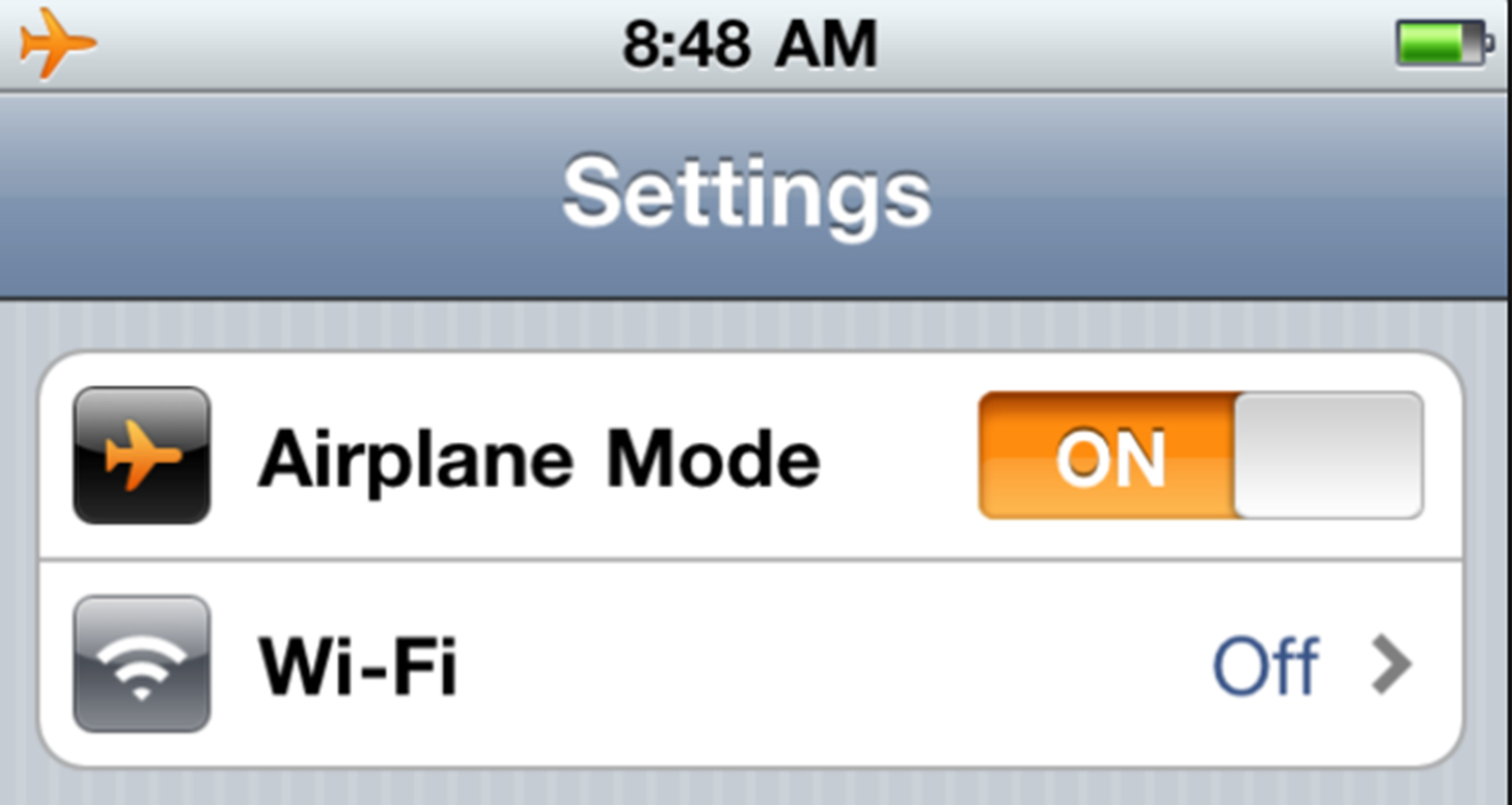

Supporting focus

Slide 21

Information sharing

Slide 22
SATs week organisation
Timings
English: grammar, punctuation and spelling.
Monday 10th May | English: grammar, punctuation and spelling
Tuesday 11th May | English: reading
Wednesday 12th May | Maths Paper 1 (arithmetic) Maths Paper 2 (reasoning)
Thursday 13th May | Maths Paper 3 (reasoning)
English: reading.
Maths paper 1 (arithmetic) and paper 2 (reasoning).
Maths paper 3 (reasoning).

Slide 23
SATs week organisation
Children arrive from 8am.
Healthy breakfast with their friends and teachers.
Tests located in the hall and a range of smaller rooms, supported by recognised staff.
Breaks between papers.
Resume lessons with increased well-being and mindful
exercises incorporated.

Slide 24




Support on the day

Slide 25
English

Slide 26
English overview
English at Alameda Middle School focuses upon three core areas:
Reading
Writing
Grammar
We are on a journey to prepare your child for the end of KS2, and to lay the foundations for the challenges of KS3 and beyond.

Slide 27
English overview
6 lessons of English each week
  One dedicated library lesson
Homework is set weekly – SATs Bootcamp (reading and SPaG)
Reading and writing skills are tracked and assessed throughout the year
Speaking and listening skills are developed in English lessons
  E.g. through talk for writing and drama

Slide 28
Grammar, Punctuation and Spelling: Monday 11th May
Grammar, Punctuation and Spelling: May 10th
Grammar, punctuation and spelling consists of two papers:
Paper 1 focuses on all three elements (grammar, punctuation and spelling or SPaG). The paper lasts for 45 minutes.
Paper 2 consists of a spelling test only. It should take approximately 15 minutes, although this is not a set amount of time.
28

Slide 29
Grammar, Punctuation and Spelling: Paper 1 (GPS)
Grammar, Punctuation and Spelling: May 10th
The children will have been working hard with their class teacher on developing and securing their knowledge of the technical vocabulary needed in this test.
This test focuses on:
Grammatical terms/ word classes;
Functions of sentences;
Combining words, phrases and clauses;
Verb forms, tenses and consistency;
Punctuation;
Vocabulary;
Standard English and formality.
This test requires a range of answer types but does not require longer formal answers.
Notes:
The question types include:
Circling
Drawing lines to connect
Multiple choice questions (including ticking tables)
One-word answers
Short answer questions

Slide 30
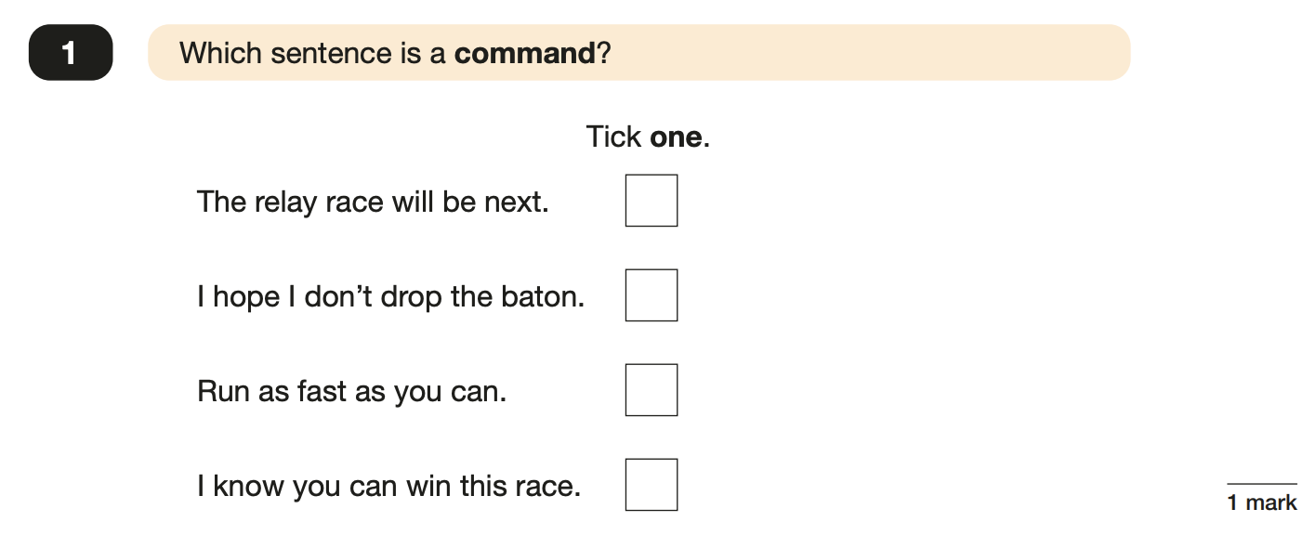
Grammar, Punctuation and Spelling: Paper 1
Example questions:
30
Notes:
Questions are from the 2023 GPS SATs paper.
For question 39, any appropriate subordinating conjunction can be used.
For question 49 the answer scheme details several correct answers and answers that should not be accepted (e.g. misspellings of verb forms or errors in punctuation or capitalisation.)

Slide 31
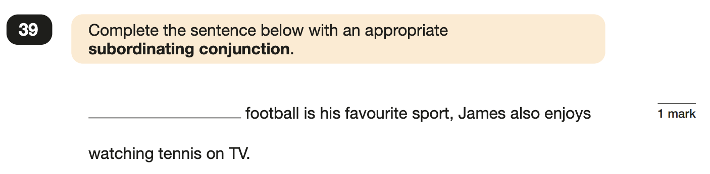
Grammar, Punctuation and Spelling: Paper 1
Example questions:
E.g. Although, while
✓
Notes:
Questions are from the 2023 GPS SATs paper.
For question 39, any appropriate subordinating conjunction can be used.
For question 49 the answer scheme details several correct answers and answers that should not be accepted (e.g. misspellings of verb forms or errors in punctuation or capitalisation.)

Slide 32
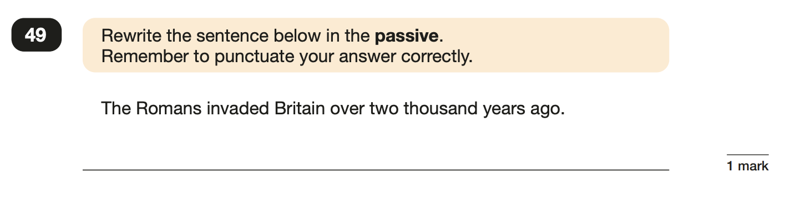
Grammar, Punctuation and Spelling: Paper 1
Example questions:
e.g. Over two thousand years ago, Britain was invaded by the Romans.
Notes:
Questions are from the 2023 GPS SATs paper.
For question 39, any appropriate subordinating conjunction can be used.
For question 49 the answer scheme details several correct answers and answers that should not be accepted (e.g. misspellings of verb forms or errors in punctuation or capitalisation.)

Slide 33
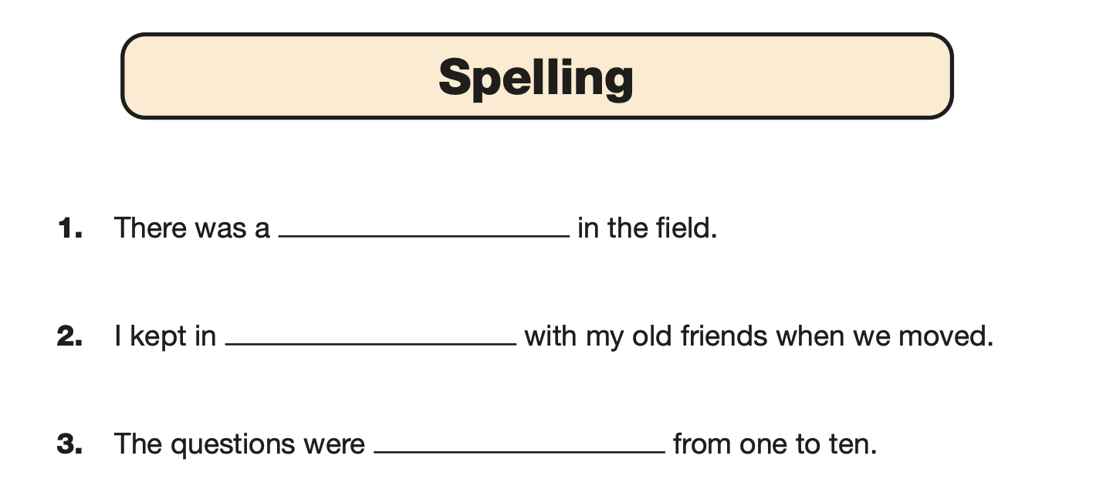
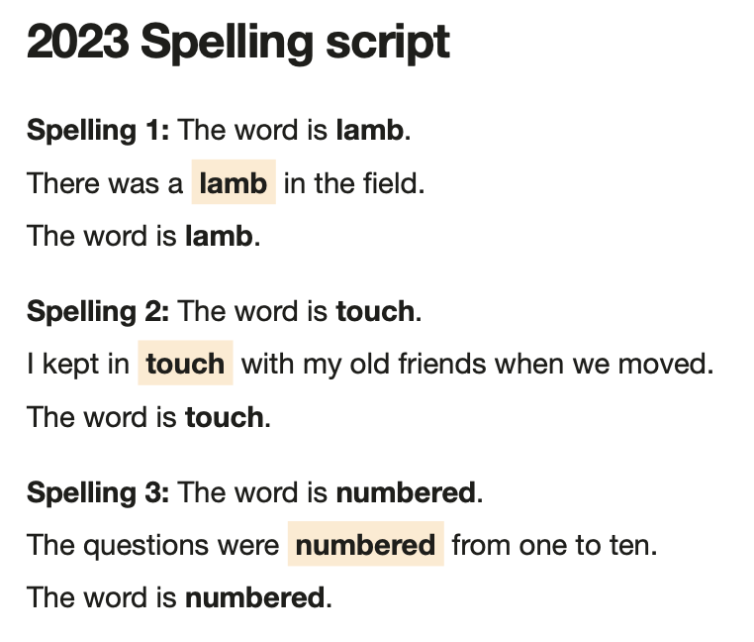
Grammar, Punctuation and Spelling:
Paper 2 (spelling)
Paper 2 is a shorter paper that focuses solely on spellings.
Example questions:
Notes:
Questions are from the 2023 Spelling SATs paper.

Slide 34

Reading: Tuesday 11th May
There is one reading test that lasts for 60 minutes.
There are three different set texts for children to read. These could be any combination of non-fiction, fiction and/ or poetry.
The test covers the following areas (known as Content Domains):
Give/ explain the meaning of words in context;
Retrieve and record information/ identify key details from fiction and non-fiction;
Summarise main ideas from more than one paragraph;
Make inferences from the text/ explain and justify inferences with evidence from the text;
Predict what might happen from details stated and implied;
Identify/ explain how information/ narrative content is related and contributes to meaning as a whole;
Identify/ explain how meaning is enhanced through choice of words and phrases;
Make comparisons within the text.

Slide 35
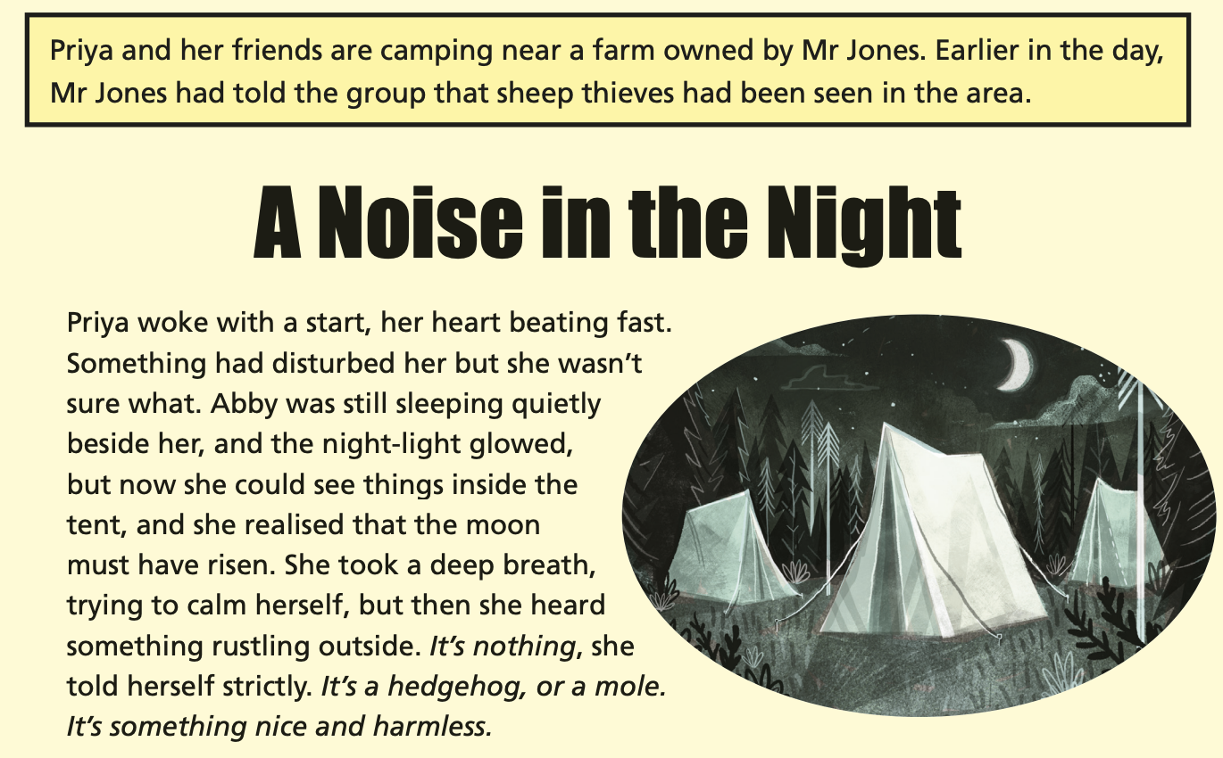
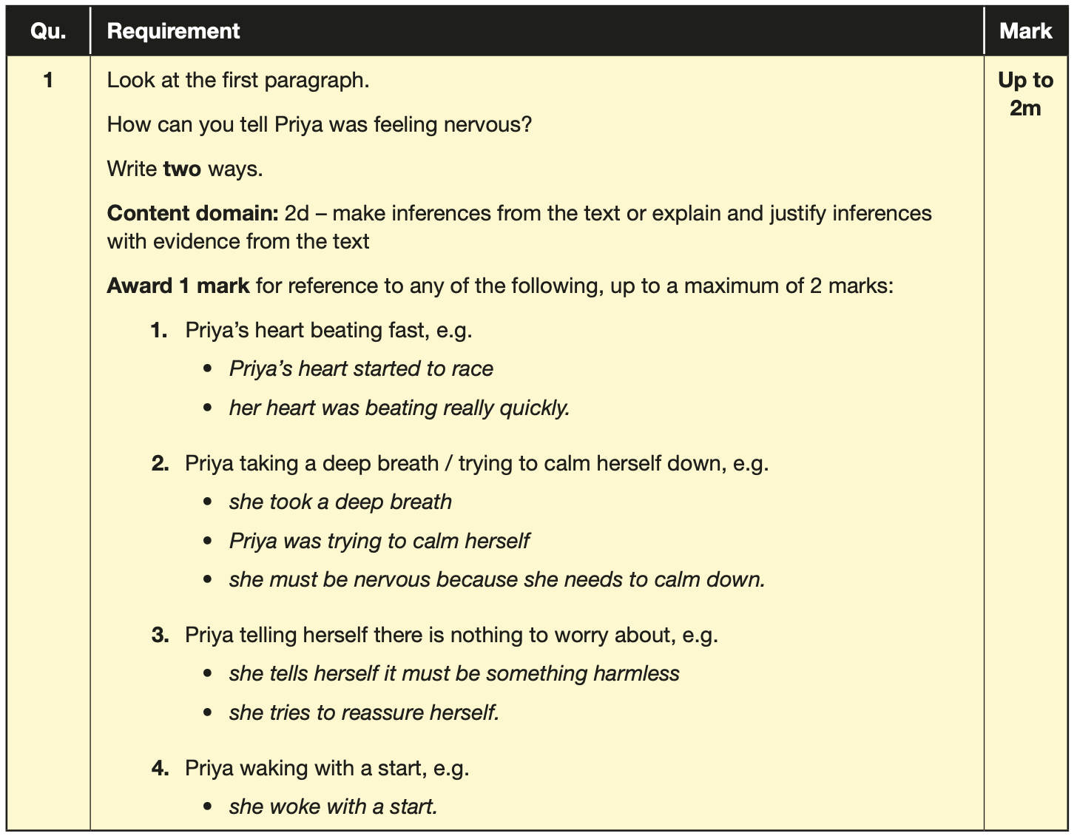
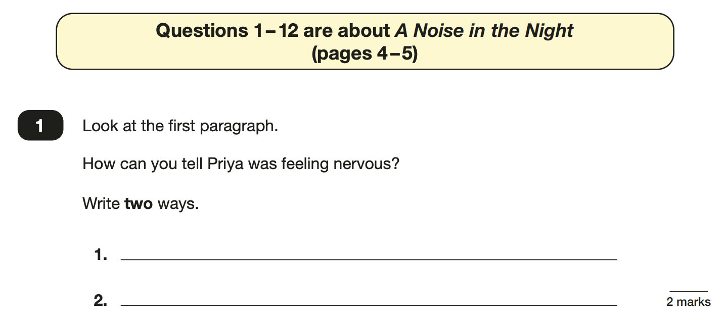
Reading
The reading SATs paper requires a range of answer styles.
Example questions:
Notes:
Questions are from the 2023 Reading SATs paper.
Question styles include:
Multiple choice questions
One-word answers
Short answer questions
Multiple mark (long answer) questions

Slide 36
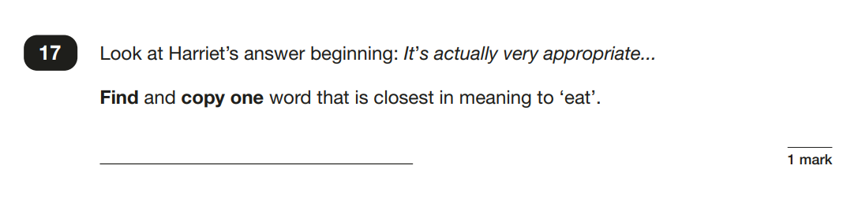
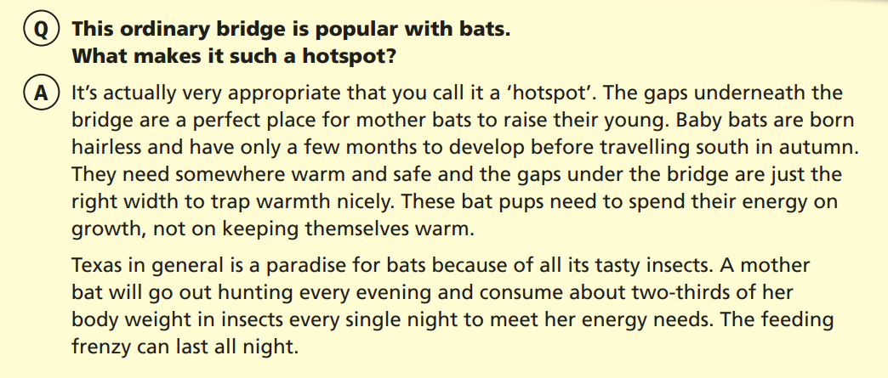
Reading

Slide 37
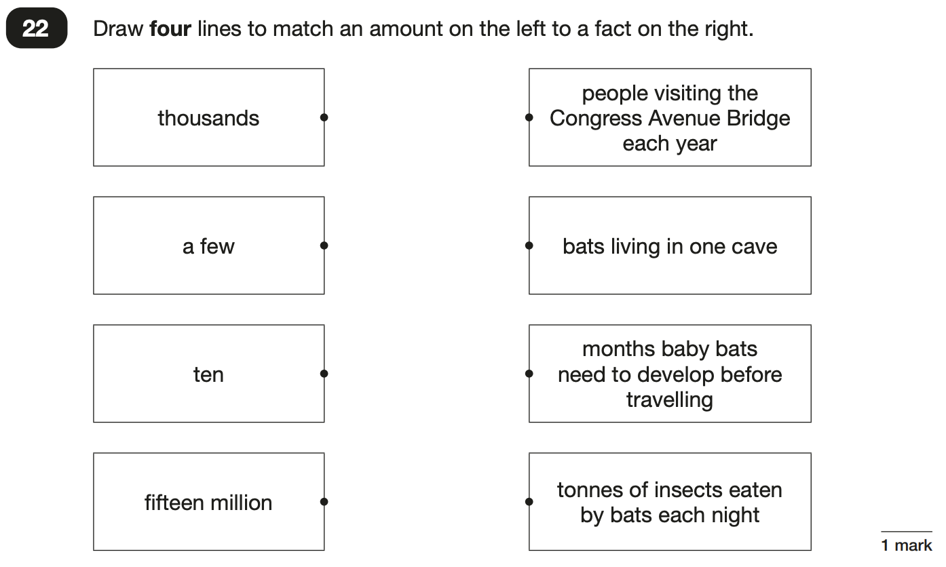
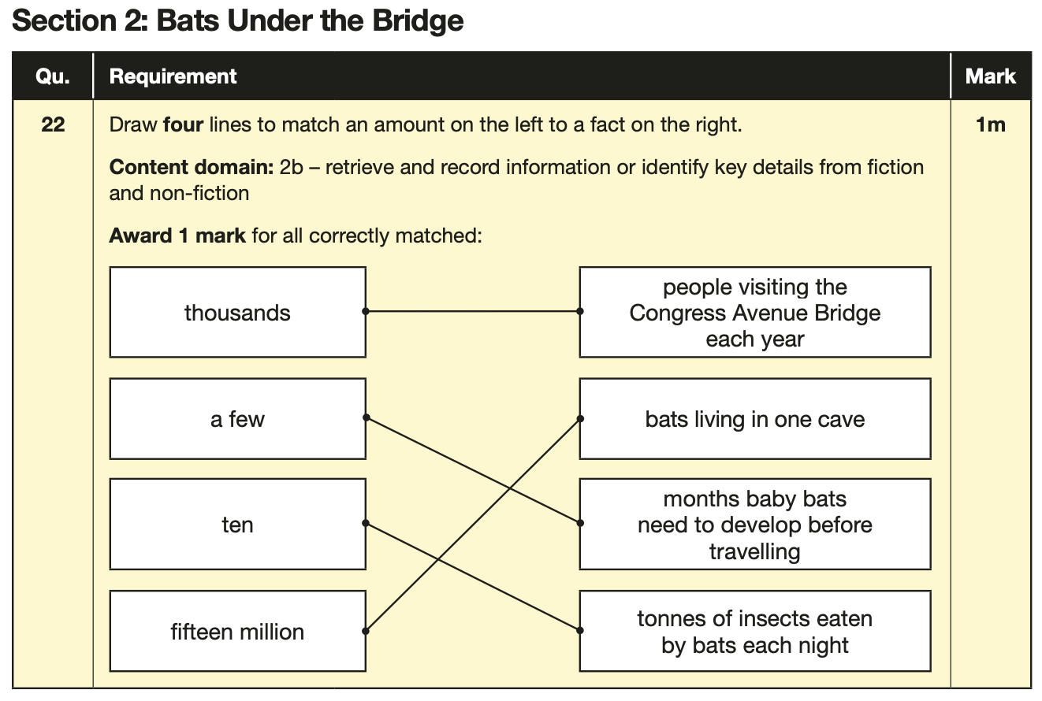
Reading
Example questions:
Based on text 2: Bats Under the Bridge
Notes:
Questions are from the 2023 Reading SATs paper.

Slide 38
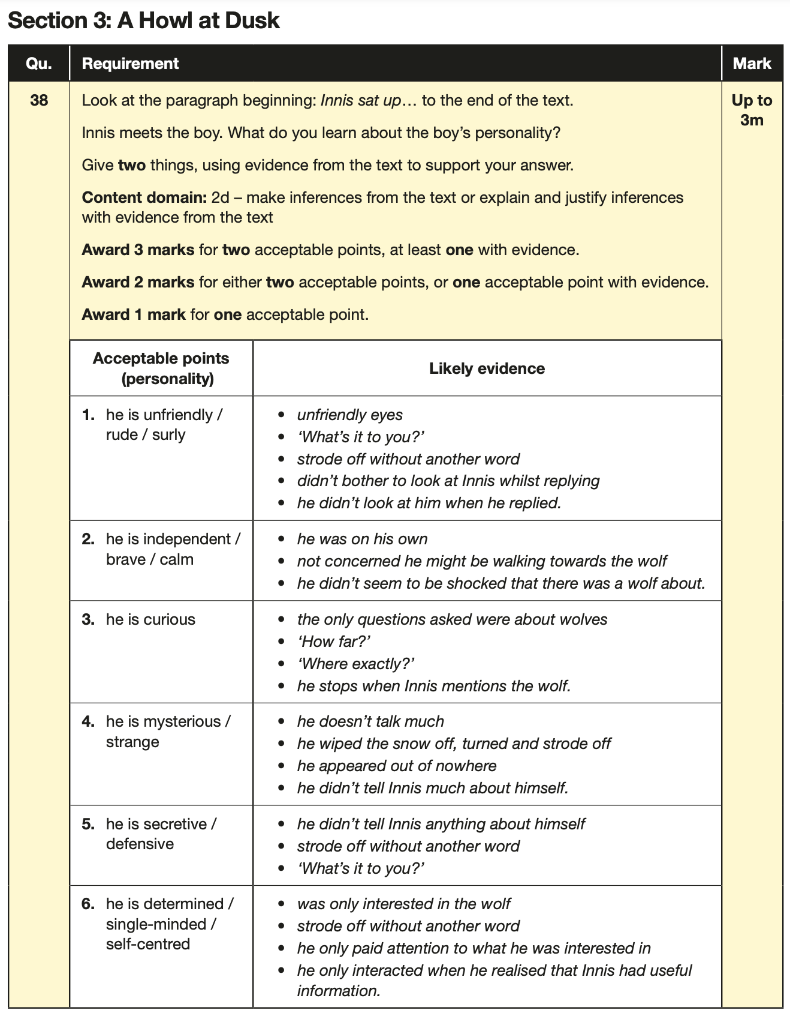
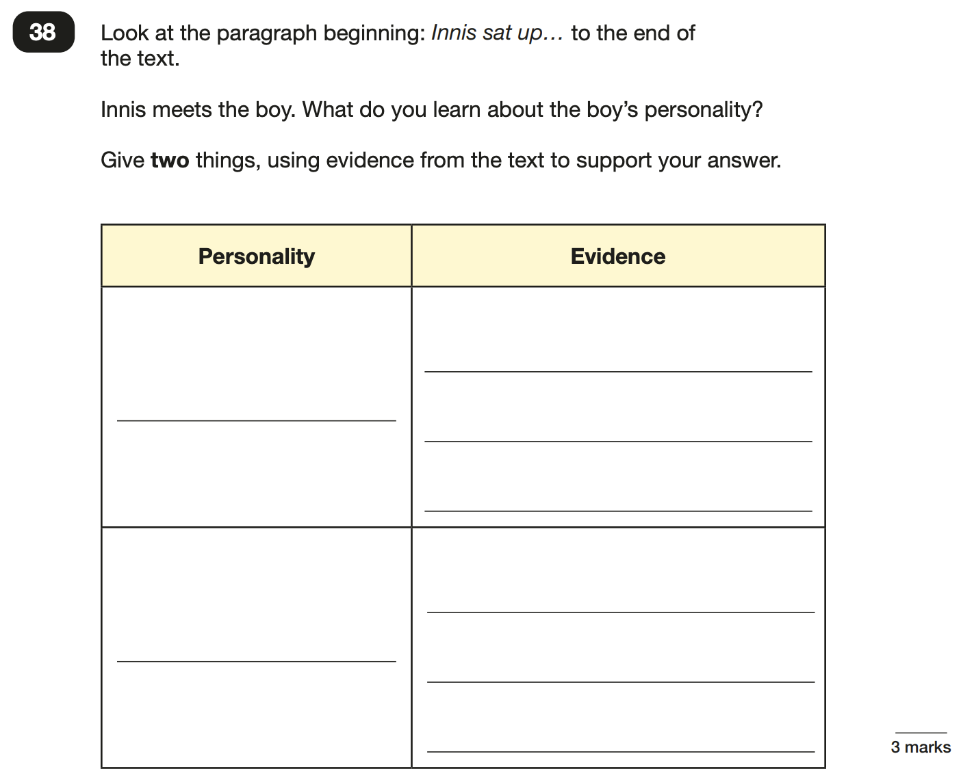
Reading
Example questions: 3 mark question
Notes:
Questions are from the 2023 Reading SATs paper.

Slide 39
Reading
Since the current testing formation for the SATs began in 2016, there has been a tendency for three types of questions to be the most popular.
In the latest Reading SATs paper,
18% of marks could be gained from answering questions involving giving and explaining the meaning of words in context;
32% of marks could be gained from answering questions involving retrieving and recording information or identifying key details from a text;
46% of marks could be gained from answering questions involving making inferences from a text and justifying inferences with text evidence.
When reading with your child at home try focusing on these types of questions.
Notes:
2% of questions: summarising main ideas from more than one paragraph.
2% of questions: identify and/ or explain how information or narrative content is related and contributes to meaning as a whole
Example questions to ask at home:
What does this word mean?
Which word in this paragraph is the closest in meaning to…?
What [character] doing when [event] happened?
True or false questions about a paragraph/ text.
Why do you [character] did [event]? Can you think of another reason?

Slide 40
Writing
During each unit of study in Year 6, your child will complete at least one writing assessment.
This is assessed using the KS2 statutory framework
From each piece of writing, your child will know what they have had success with
Your child will also be given a target – they are given the opportunity to work on this area, before improving on this in their writing
In addition, your child will undertake writing across the curriculum.
e.g. science experiment reports and recounts demonstrating their learning in history.

Slide 41
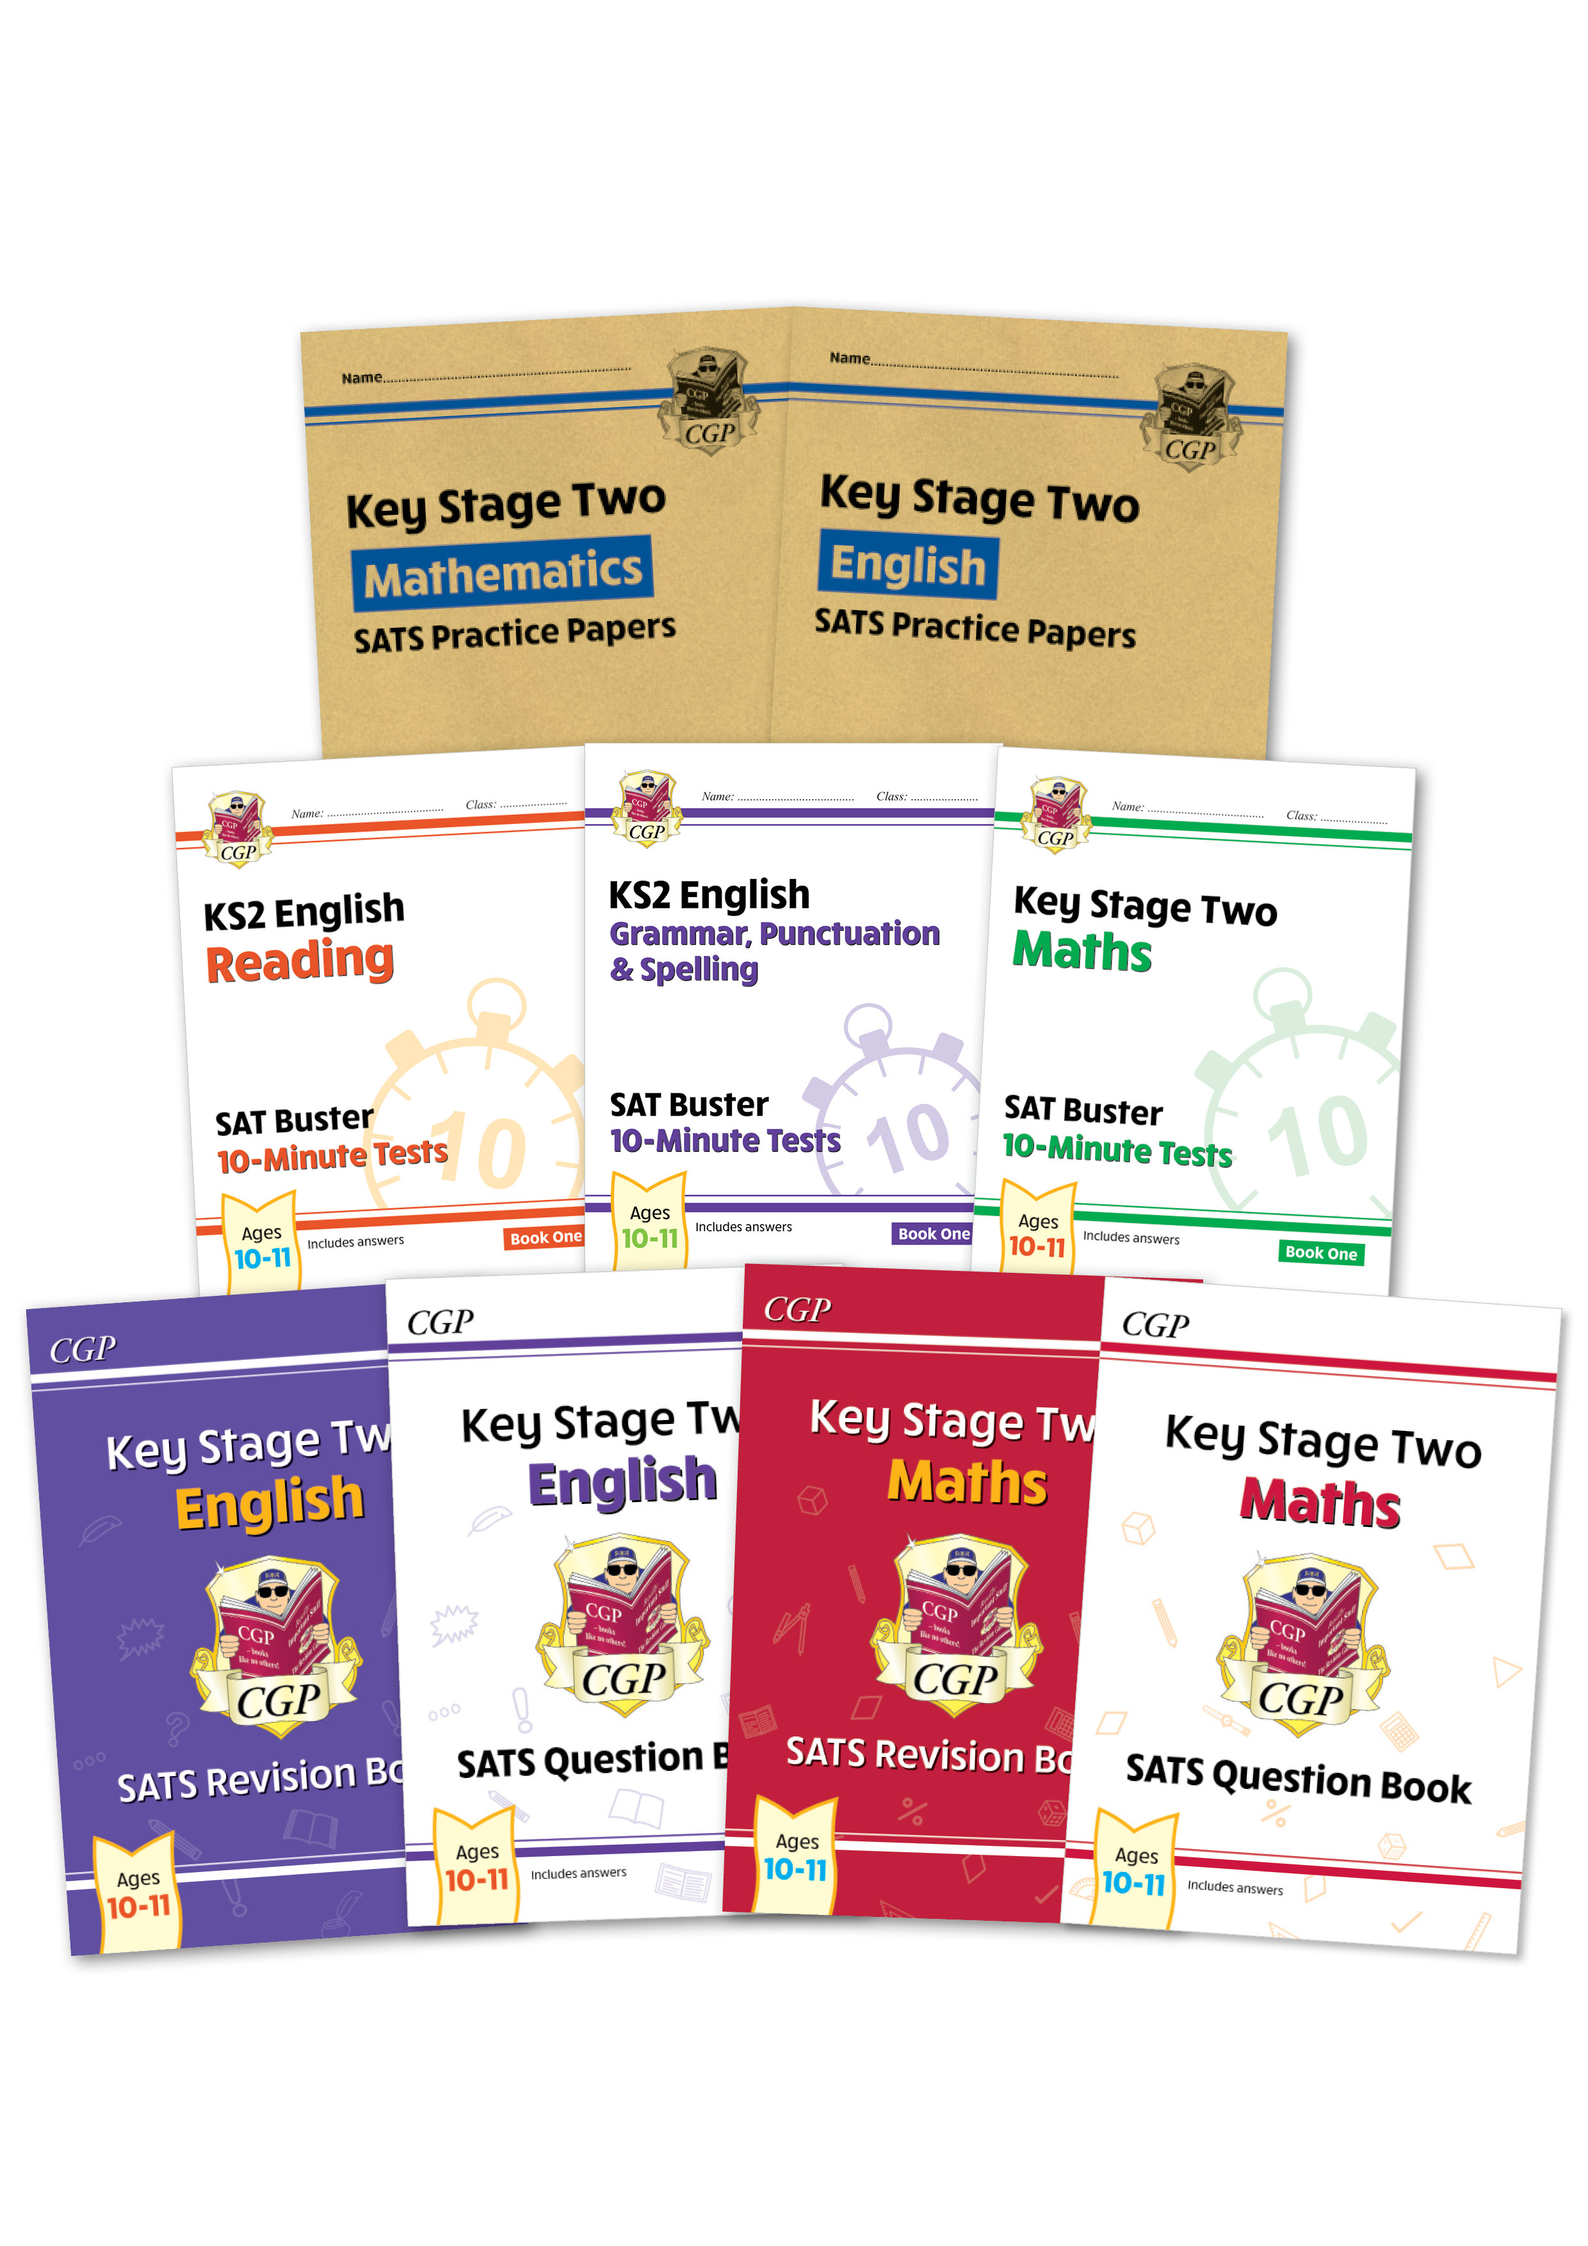
Supporting your child in preparing for the English SATs
Tips:
Support with the completion of homework
Find the buzz words in any questions or tasks that they are sent home – encourage them to highlight
Read with your child regularly, then ask them questions using the question stems
When reading with your child, discuss the use of punctuation: inverted commas to mark speech; the use of capital letters etc. (see the handout for SPaG terms)
Read aloud to your child whilst your child follows the text: listening is an important part of reading; it will help your child learn the importance of punctuation and reading with expression
Capital letters and sentence punctuation are key to success – remind your child when they complete any homework.
Groups
Notes:
We encourage parents not to use past papers at home. If they want to use past papers with tutors, you could take copies of completed tests home to work through with tutors. This may help pupils to work through specific misunderstandings.

Slide 42
Maths

Slide 43
Maths Overview:
We are on a journey to prepare your child for the end of KS2, and to lay the foundations for the challenges of KS3 and beyond.
EXS will lay the foundations for a GCSE pass.
3 Papers
Paper 1: Arithmetic – 30 minutes – 40 marks (Wednesday 12th May)
Paper 2: Reasoning 1 – 40 minutes – 35 marks (Wednesday 12th May)
Paper 3: Reasoning 2 – 40 minutes – 35 marks (Thursday 13th May)

Slide 44
Maths Overview:
5 lessons a week
Homework is set weekly – Paper or MathsWatch
TTRockstars – little and often – 3x a week
Daily fluency – linked to arithmetic questions
Reasoning Questions woven throughout the curriculum
Times tables will be tracked and assessed throughout the year
By February a lesson will become an Arithmetic lesson to practice these key skills.

Slide 45
Strand | 2016 | 2017 | 2018 | 2019 | 2022 | 2023 | 2024 | Total raw marks
C: Calculations | 41 | 40 | 47 | 42 | 46 | 39 | 42 | 297
F: Fractions, decimals and percentages | 24 | 23 | 24 | 29 | 28 | 26 | 26 | 180
N: Number and place value | 11 | 11 | 8 | 9 | 8 | 10 | 10 | 67
M: Measurement | 11 | 11 | 7 | 12 | 6 | 8 | 11 | 66
R: Ratio and Proportion | 6 | 6 | 7 | 4 | 7 | 9 | 4 | 43
G: Geometry: properties of shape | 7 | 6 | 6 | 6 | 6 | 6 | 6 | 43
A: Algebra | 4 | 7 | 8 | 7 | 5 | 5 | 4 | 40
S: Statistics | 4 | 4 | 2 | 2 | 2 | 5 | 5 | 22
P: Position and direction (geometry) | 2 | 2 | 1 | 3 | 2 | 2 | 2 | 14
The raw mark totals for each strand per year and their total for arithmetic and reasoning from 2016 to 2019 and 2022-2024

Slide 46
Arithmetic
Paper 1 (Arithmetic)
30 minutes
40 Marks – usually around 36 questions – Long multiplication and division are worth 2 marks each.
Assesses pupils’ confidence using methods of calculation:
            Addition
            Subtraction
            Multiplication
            Division
            Fractions – addition, subtraction, multiplication and division
            Decimals
            Percentages

Slide 47
All 4 Operations:
Addition: ____ = 67 + 9872 989899 + 997765 = 897 + 8917 + 9809 = | Subtraction: 70090 – 87651 = 123872 – 49999 =
Multiplication: 2 x 3 x 7 = 600 x 90 = 8297 x 7 = 678 x 56 = | Division: 581 ÷ 7 = 714 ÷ 17 = 8190 ÷ 45 =

Slide 48
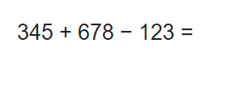
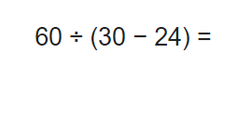
BIDMAS:

Slide 49
Decimals:
Addition: 45.67 + 891. 2 = 1892.98 + 9.87 = | Subtraction: 16.78 - 9.562 = 20 – 12.356 =
Multiplication: 16.87 x 9 = 15 x 6.1 = 3.9 x 30 = | Division: 15. 2 ÷ 2 = 32.4 ÷ 9 =
Multiply and Divide by 10, 100 and 1000: 0.02 x 1000 15 ÷ 1000 9.006 x 100

Slide 50


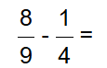





Fractions:

Slide 51


Fractions of Amounts:

Slide 52


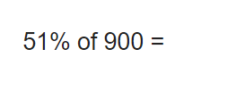
Percentages:

Slide 53
Reasoning
Papers 2 & 3 (Reasoning)
40 minutes each
35 Marks
Range of question types worth up to 4 marks.
Focus on problem solving, fluency and applying mathematical reasoning.
Questions cover the following areas (called ‘content domains’):
  Number and Place Value
  All 4 Operations
  Fractions, Decimals and Percentages.
  Geometry – Properties of Shapes & Position and Direction
  Statistics
  Measurement
  Algebra
  Ratio and Proportion

Slide 54
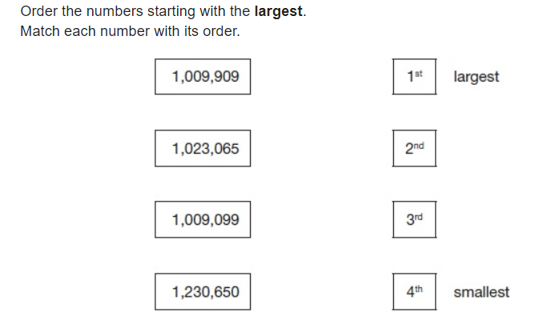
Example:

Slide 55
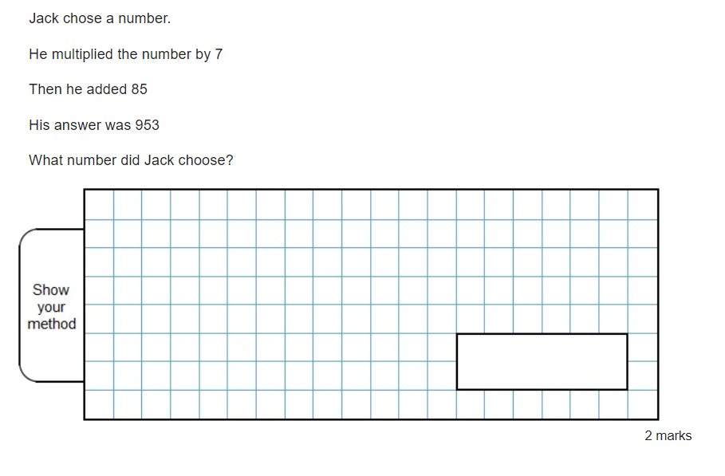
Example:

Slide 56
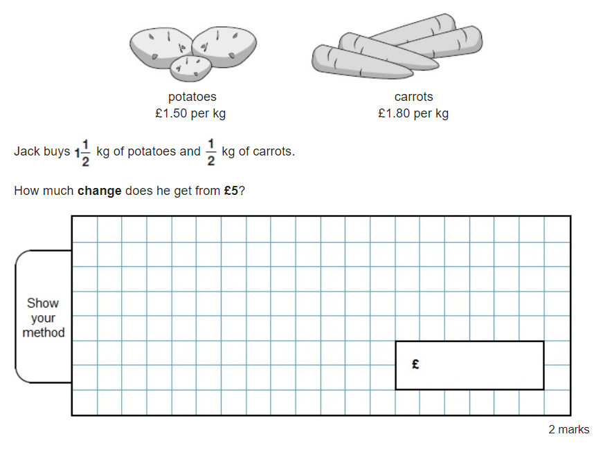
Example:

Slide 57
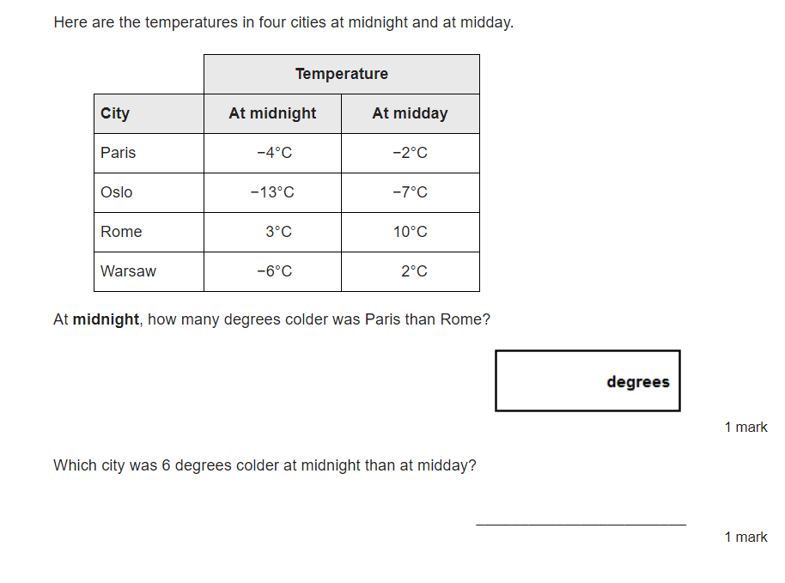
Example:

Slide 58
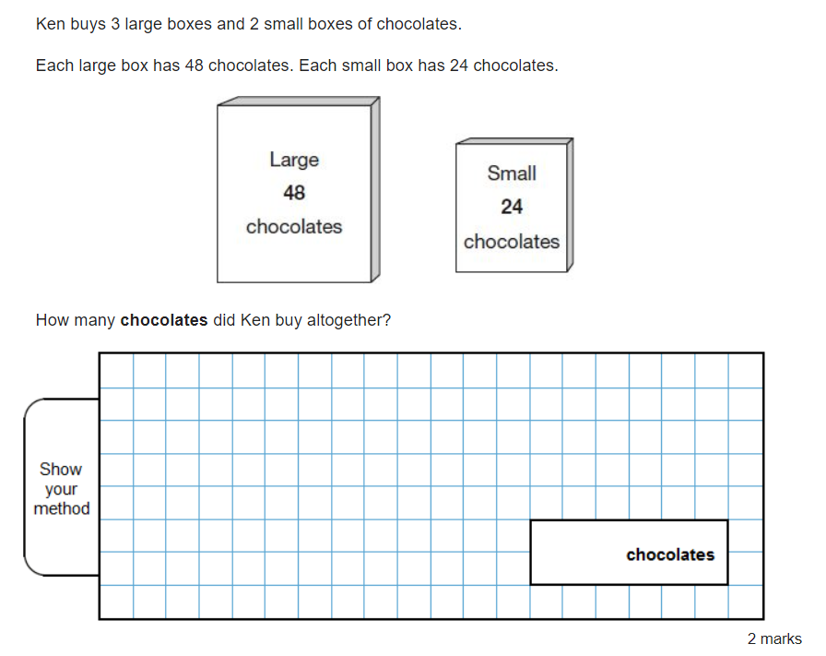
Example:

Slide 59
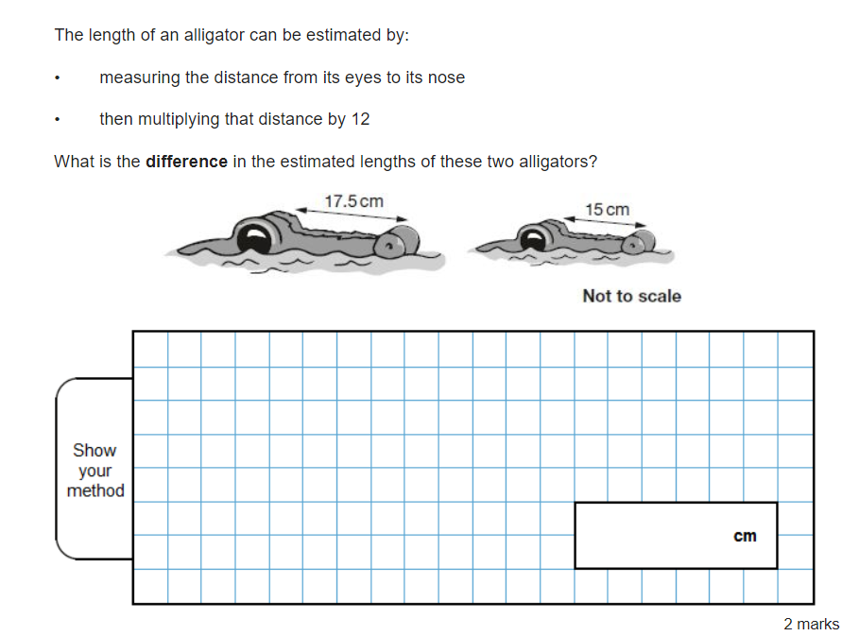
Example:

Slide 60
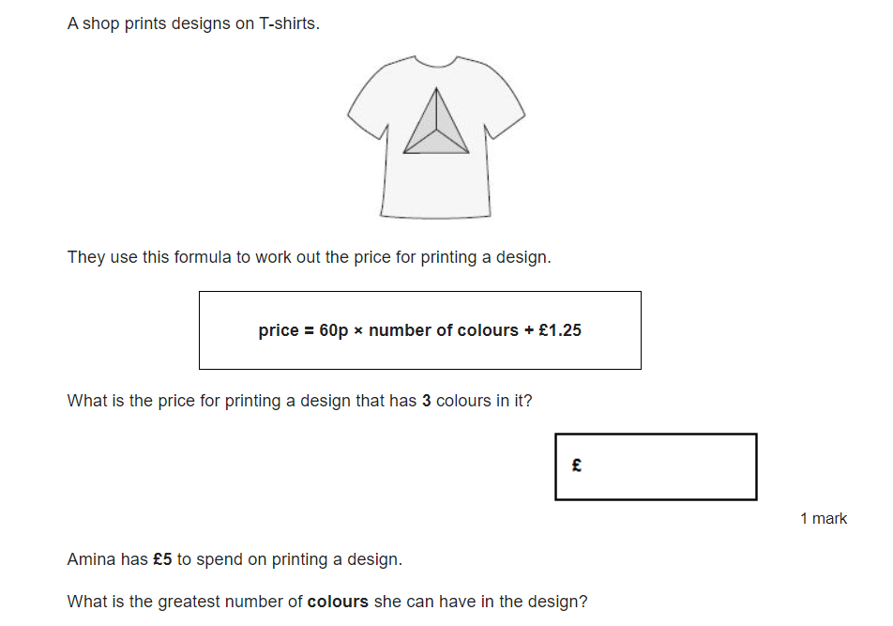
Example:

Slide 61
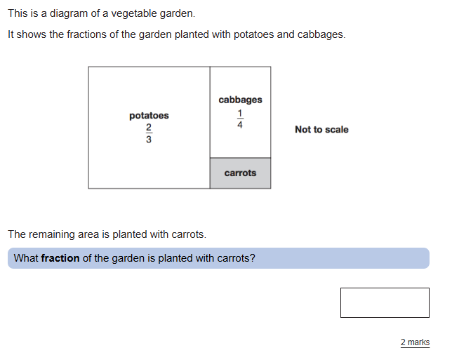
Example:

Slide 62





Slide 63
Thank you
for your support

